Slide 1

Agenda:
Development Team Overview
Project Overview
Technical Skills implemented in the project
Challenges faced & Solutions
Future version of the Project (More Ideas for Improvement)
Learning Outcome from the Project Development
Question & Answer

Slide 2
Semester project on
Travel of china

Slide 3

DEVELOPMENT
TEAM LEADER
Oreo:
Making the Home webpage and the most of function
Oscar:
Make discover webpage, almost of the CSS and PHOTOSHOP
Tony:
Make destination webpage
and a China map
Murphy:
Make strategy webpage, Searching for pictures and the PPT

Slide 4




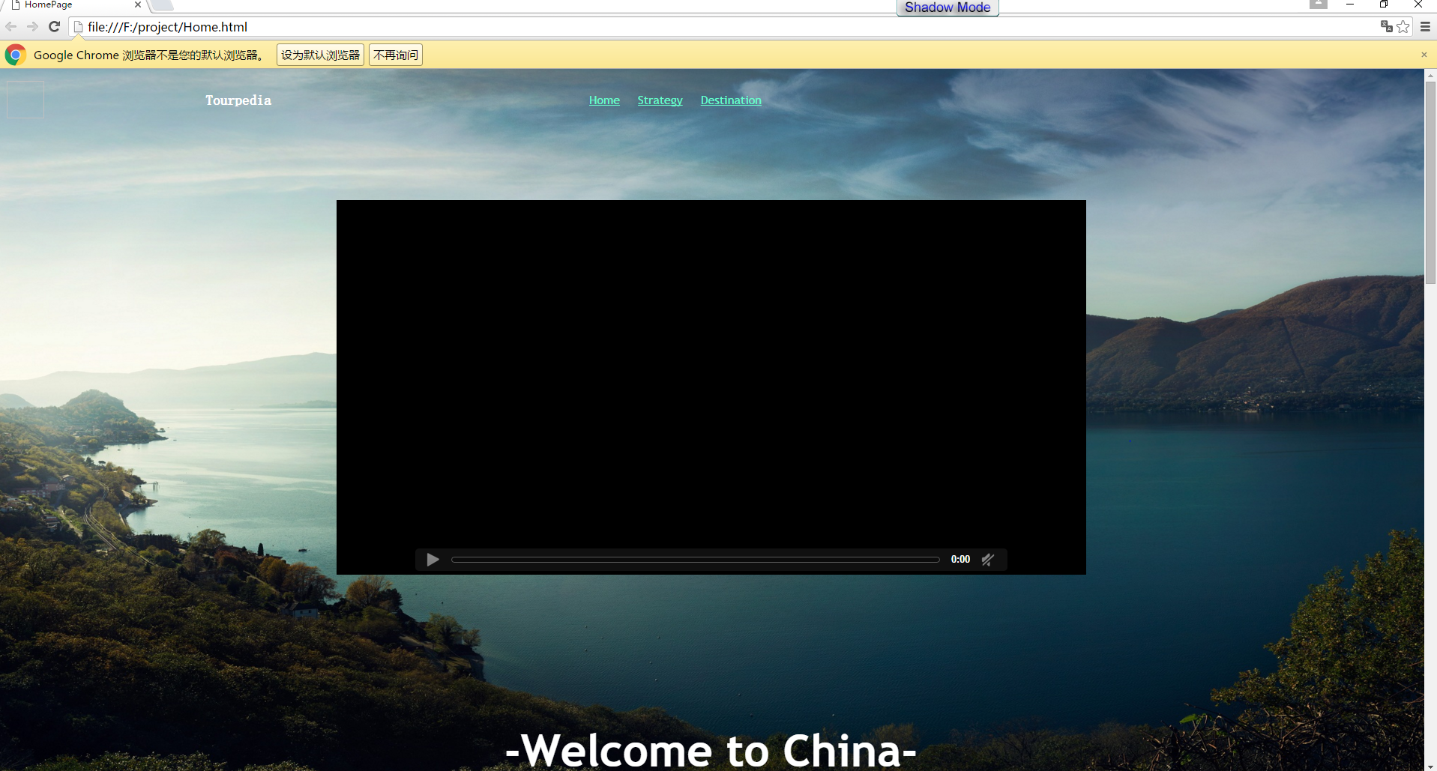
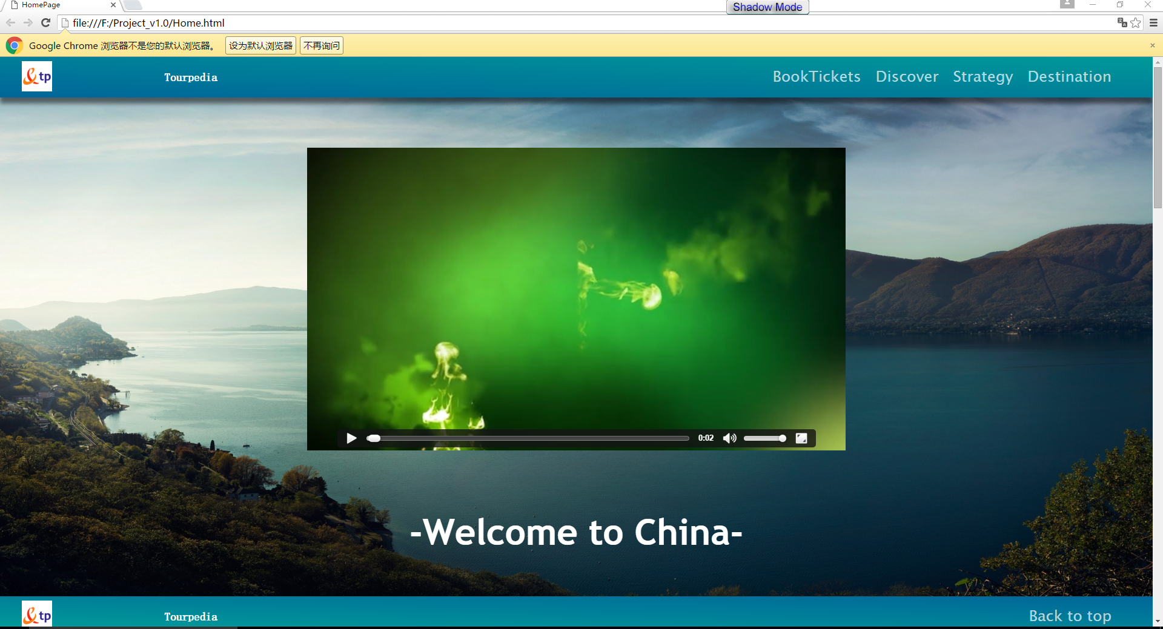
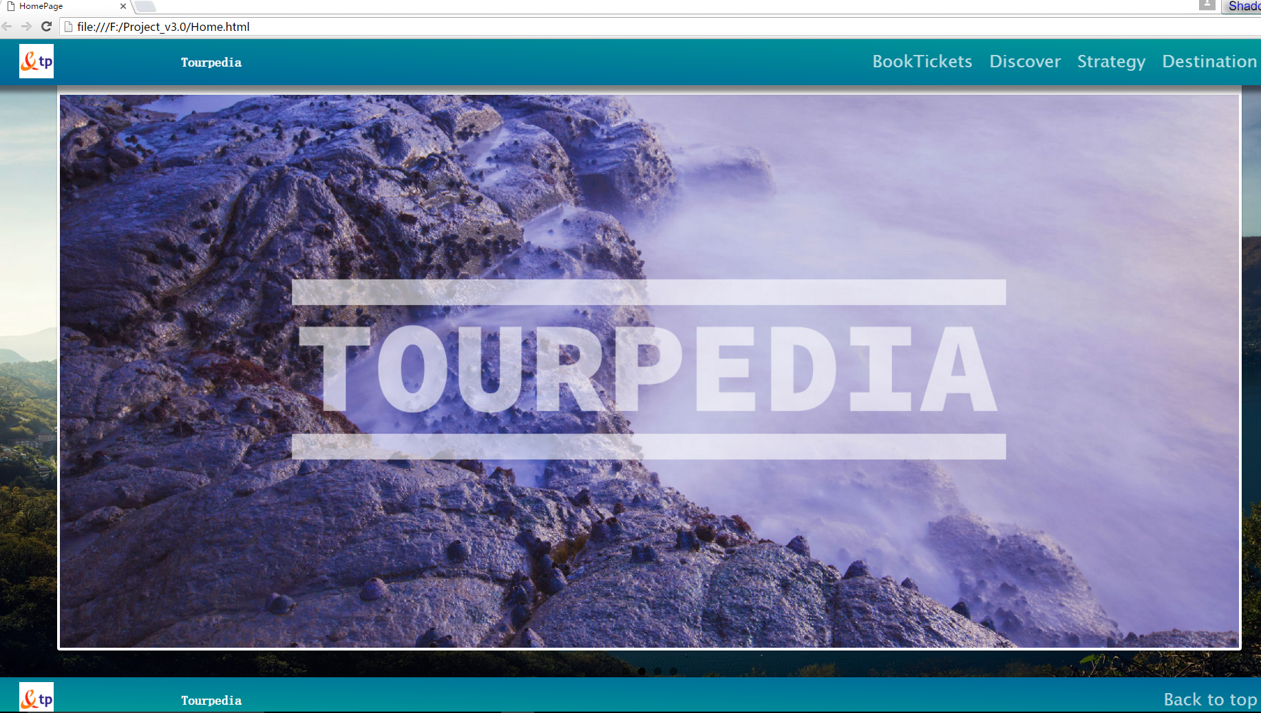
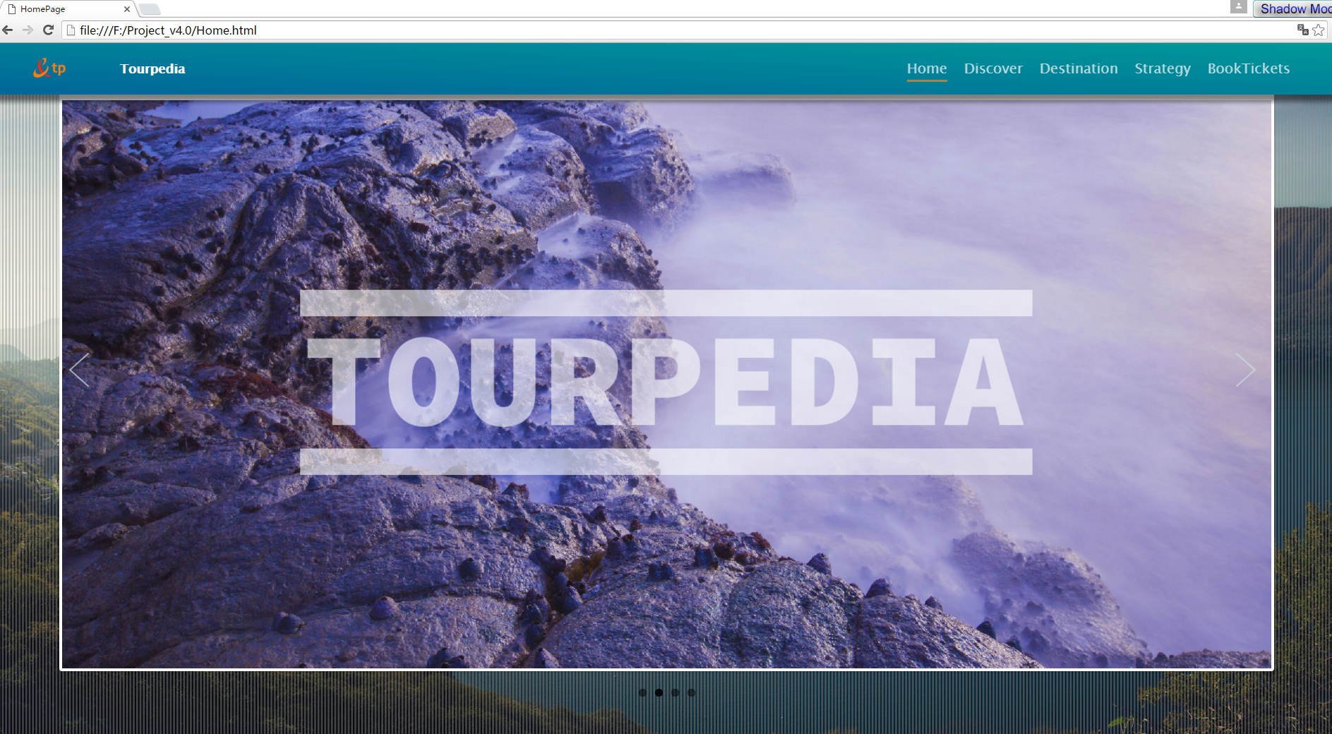
The versions of history
The Version1.0
The version 2.0
The Version 3.0
The version 4.0

Slide 5
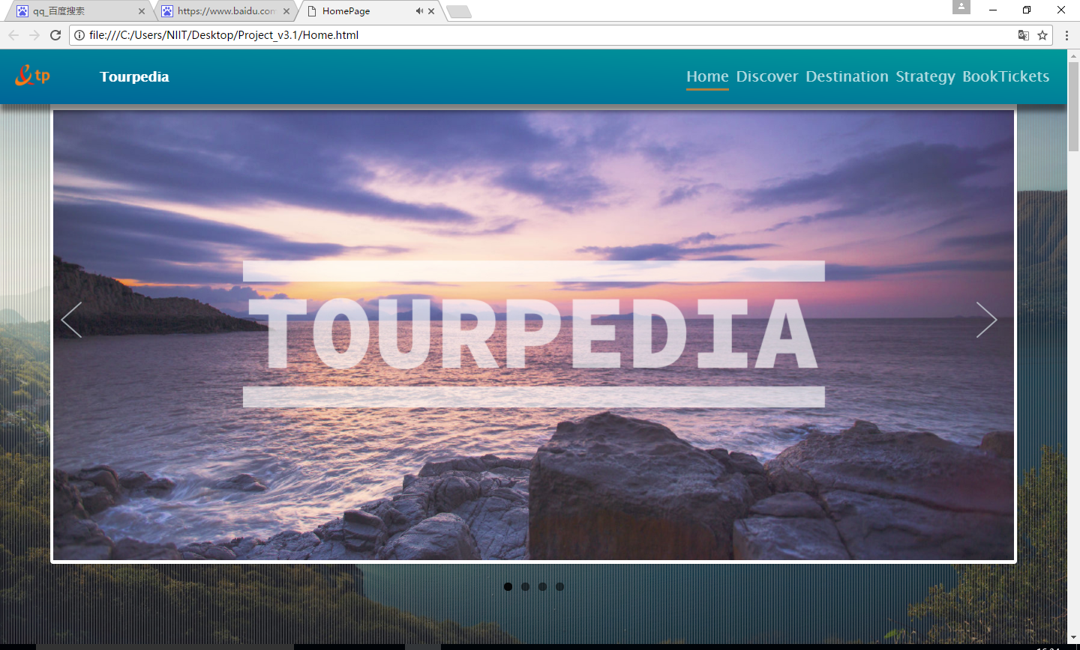
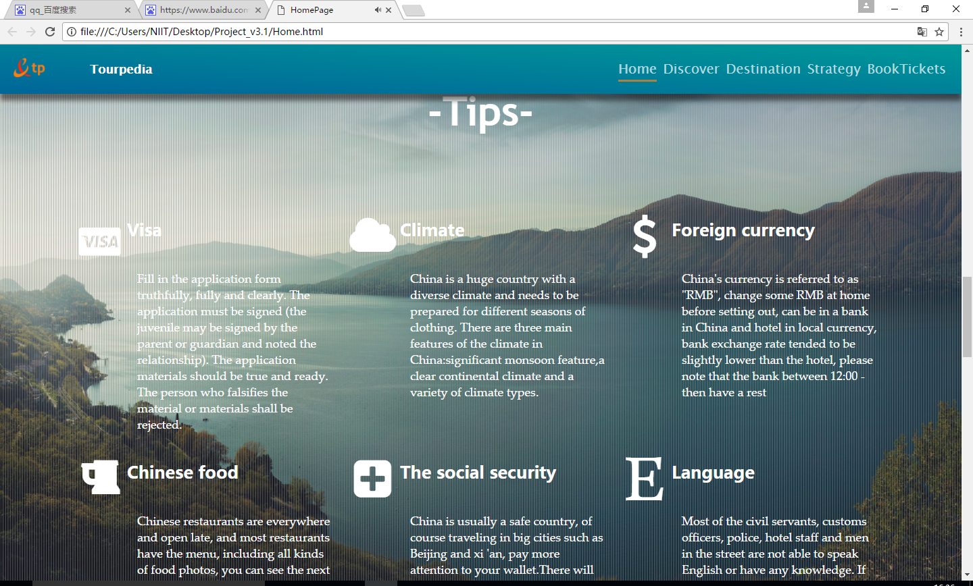
Homepage 1.

Slide 6
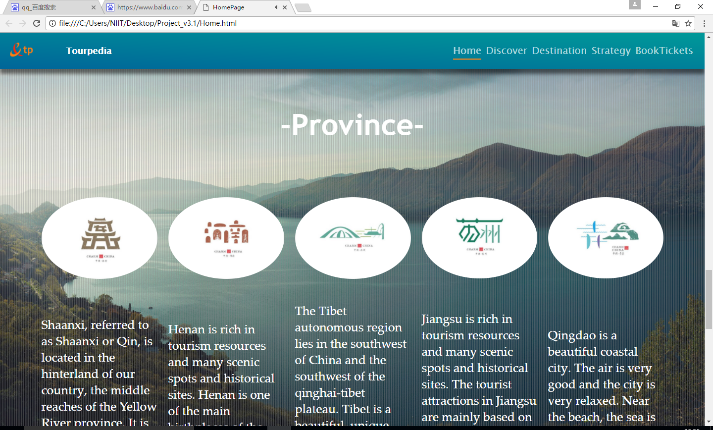
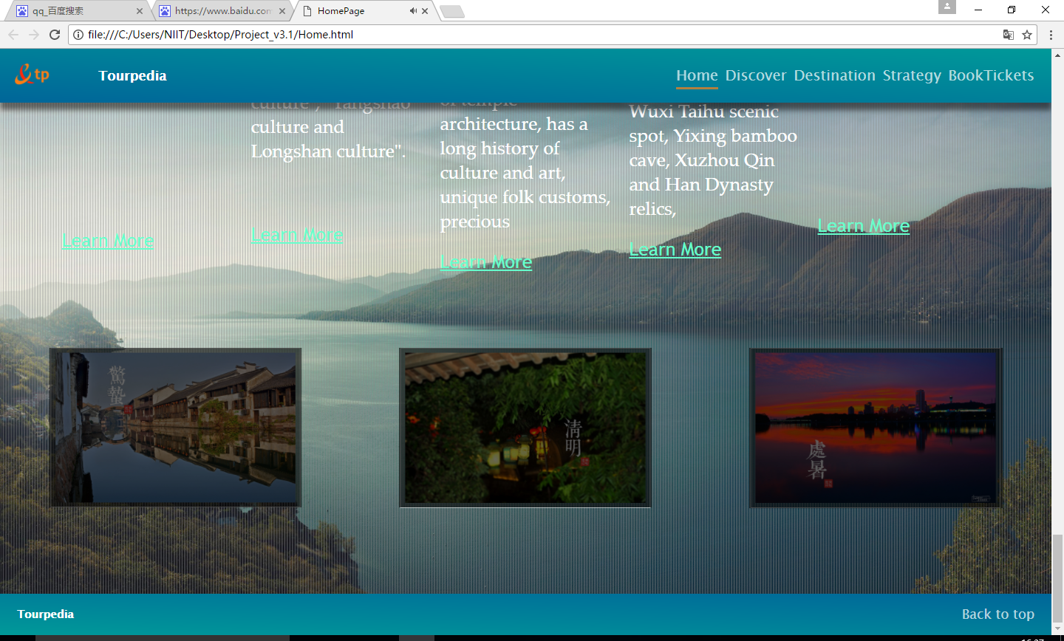
Homepage 2.

Slide 7
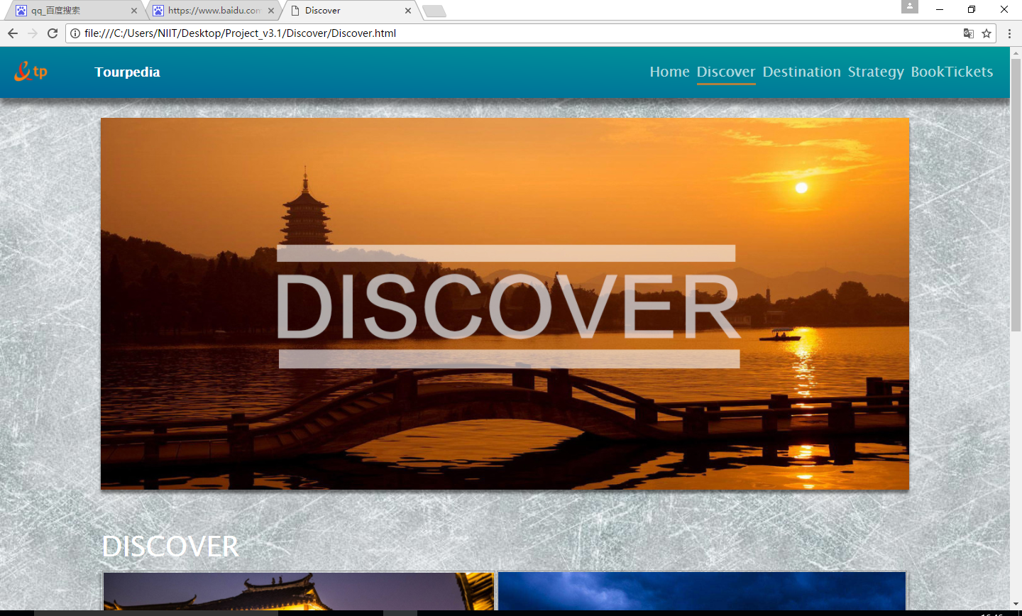
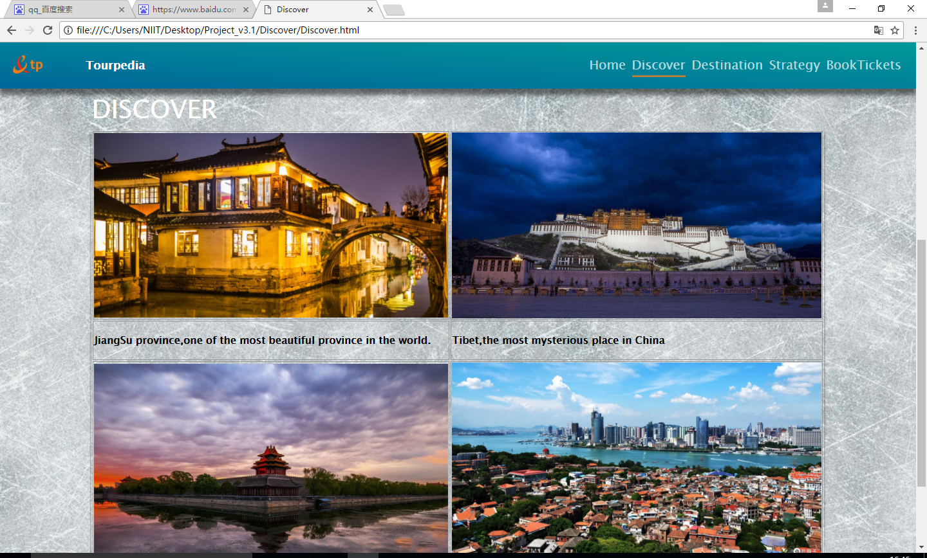
Discover

Slide 8
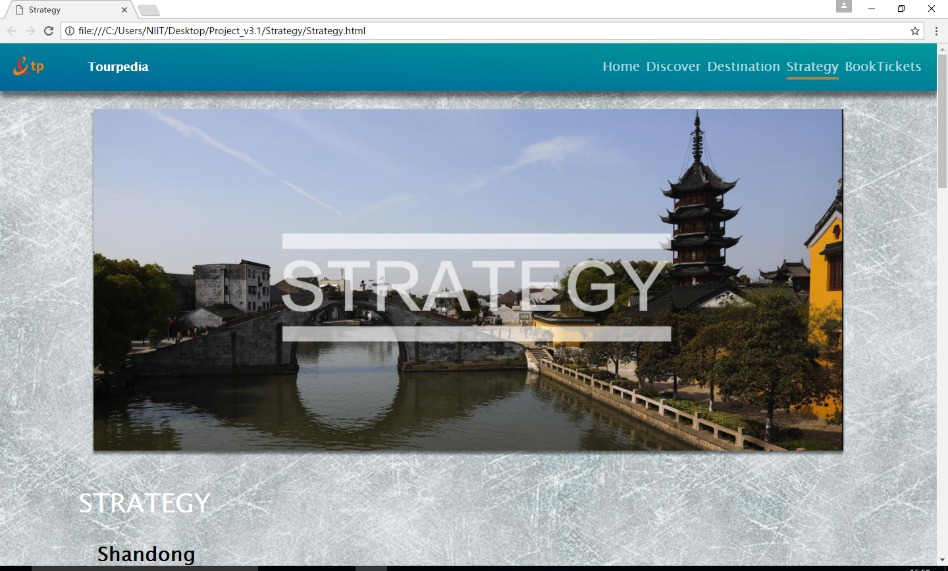
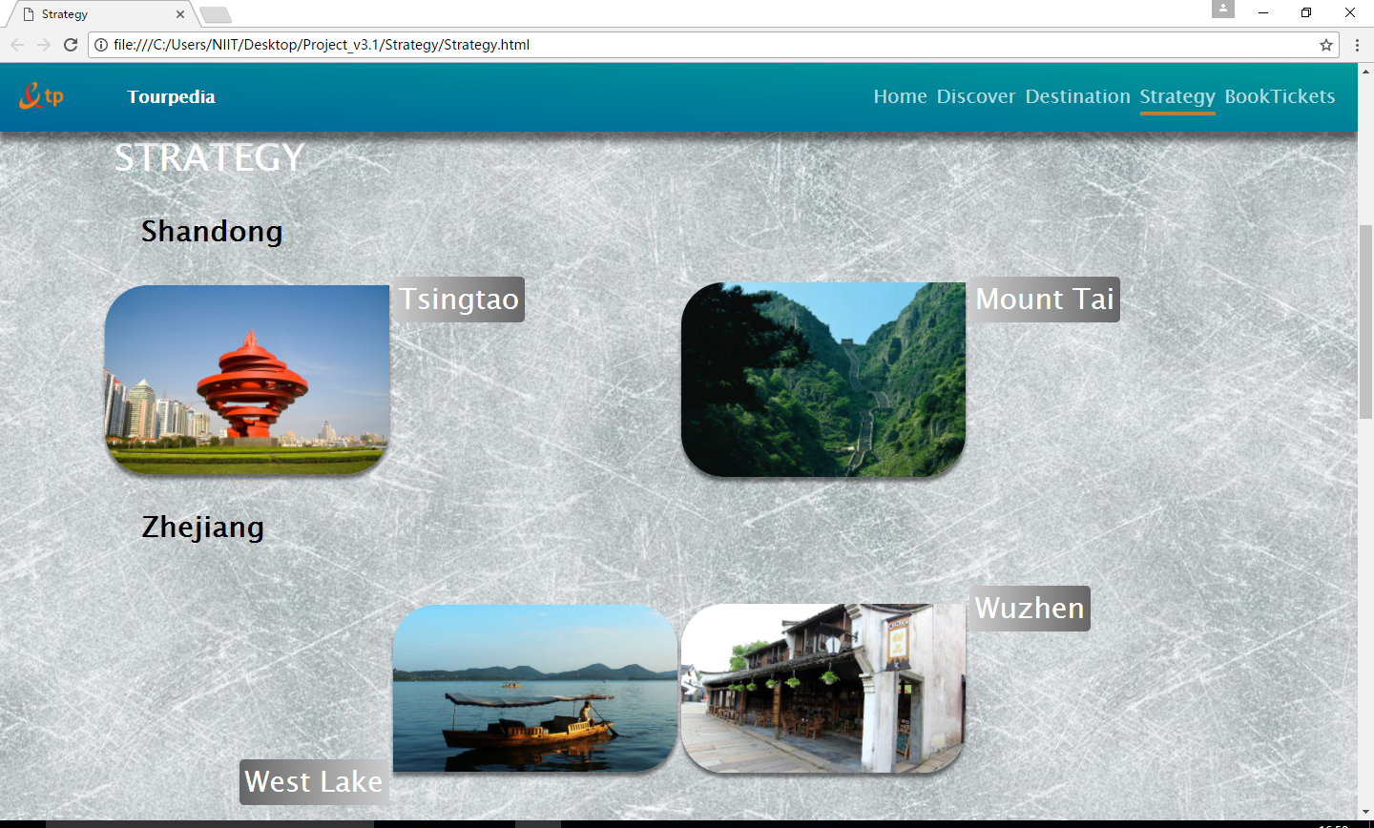
Strategy 1.

Slide 9
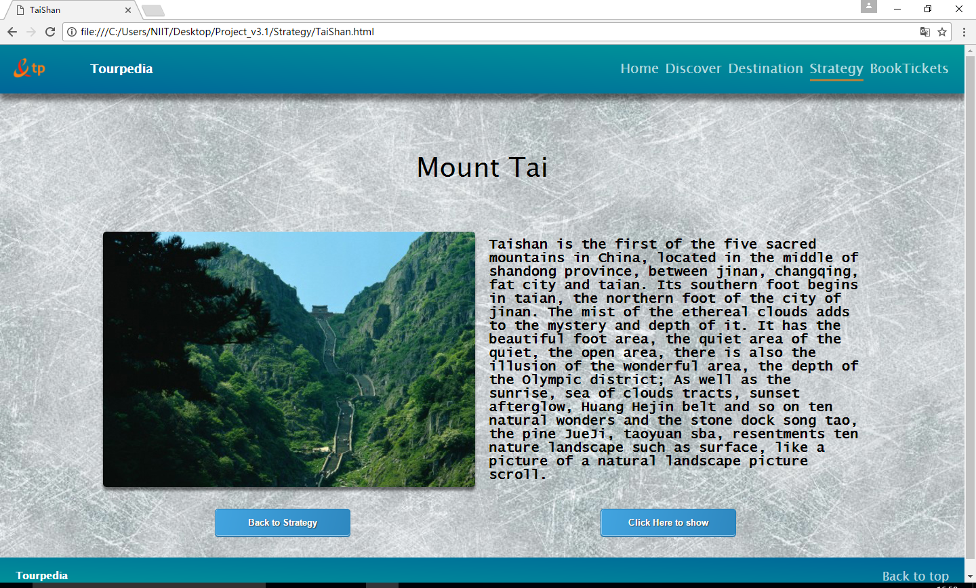
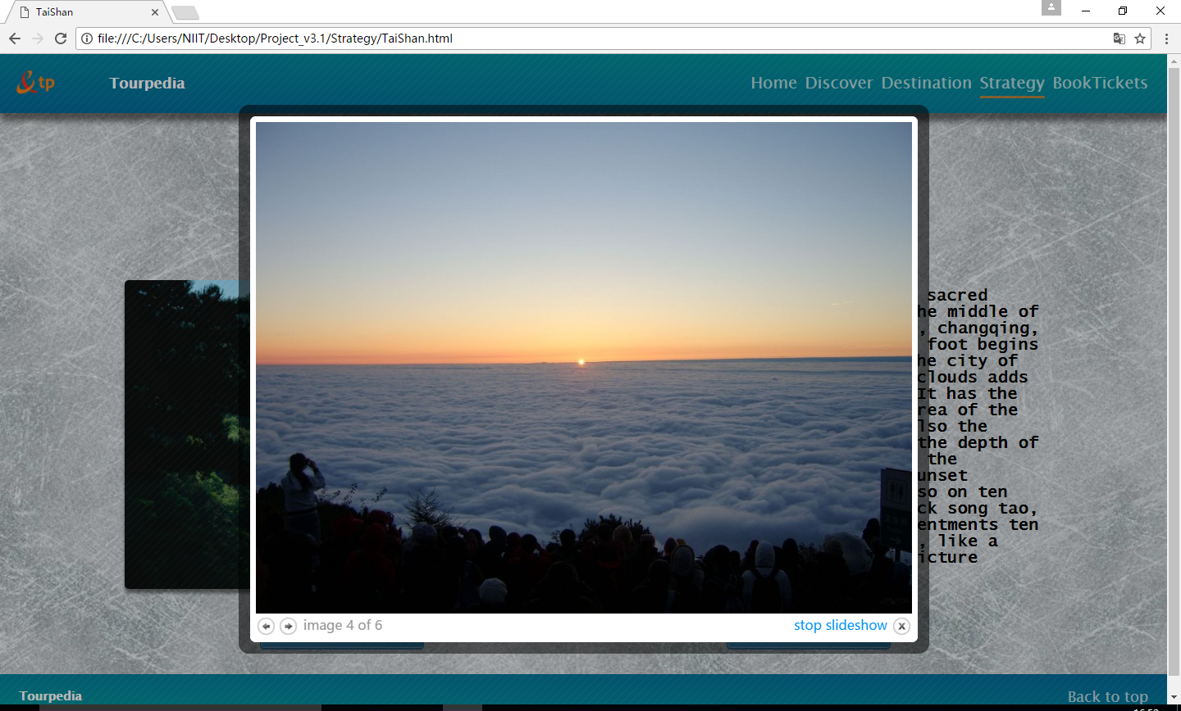
Strategy 2.

Slide 10
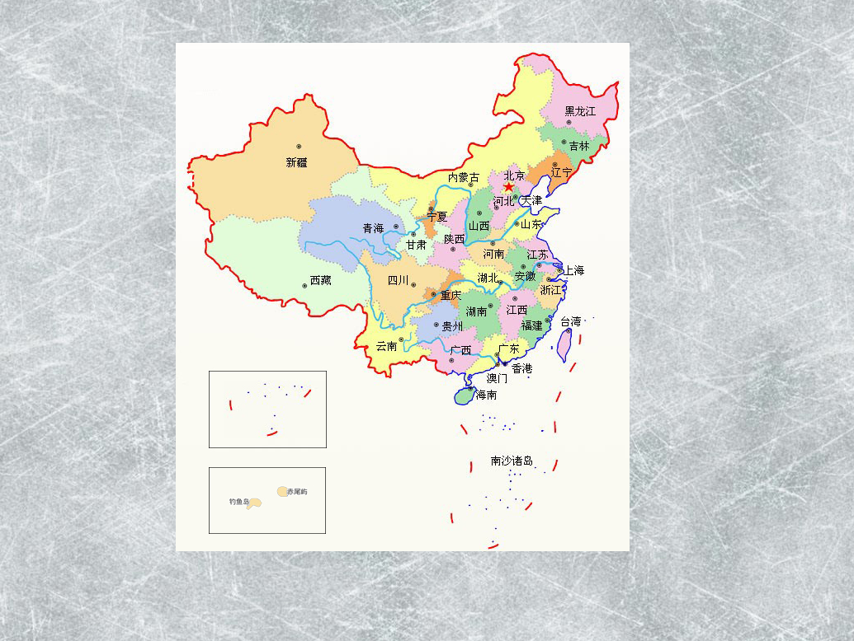
Destination 1.

Slide 11
Project Overview(Problem Statement)
Varies depending on the track
1.Make a main webpage named tourpedia
2.Make a China map that varies may functions
3.Make strategy and discover webpages.
4.How to using JS to realize the function
5.How to beautify the webpage’s interface by writing CSS

Slide 12
Technical skills used during the project
HTML-5
Java Script
jQuery
CSS
Photoshop

Slide 13
Problems Faced during the Development
Based on the actual development experience
1.To determine the main webpage’s appearance
2.To search for the information
3.How to insert the information to the webpages
4.How to beautify the webpages by using css and js

Slide 14
Main Functions
Core functions of the project
1.Colorbox
2.javascript
3.gallery
4.CSS
5.

Slide 15
Learning achieved during Project Development
Actual learning attained during the project presentation
Learn how to construct a webpages.
Learn to beautify a webpages by writing the CSS

Slide 16
Future Vision / Idea on the Project
Level-2 of the project how can the project be improved further given more time

Slide 17




Slide 18


